Slide 1
Lecture 14: Access Methods & Operators
Lecture 14

Slide 2
Pace & Lecture content
Lecture 14
We are slowing down:
In response to feedback from some that they like this pace better!
Due to great questions! Makes us seriously happy!
The details are more fun! Makes one of us seriously happy.
We may cut some topics listed (maybe not).
We have a lot of (we think) good material ☹ but…
We’d prefer depth and happiness to breadth.
Please refresh lectures before (changes are minor)
Cannot tell you how much time we spend tweaking… it’s sad really…

Slide 3
Project #2 Hint
Lecture 14
You may want to do Trigger activity for project 2.
We’ve noticed those who do it have less trouble with project!
Seems like we’re good here ☺ Exciting for us!
Definitely use piazza actively: students have been giving great answers
Hats are back ordered! (well not really)

Slide 4
Today’s Lecture
Lecture 14
B+ Trees
Nested Loop Joins

Slide 5
1. B+ Trees
Lecture 14 > Section 1

Slide 6
What you will learn about in this section
Lecture 14 > Section 1
B+ Trees: Basics
B+ Trees: Design & Cost
Clustered Indexes

Slide 7
B+ Trees
Lecture 14 > Section 1 > B+ Tree basics
Search trees
B does not mean binary!
Idea in B Trees:
make 1 node = 1 physical page
Balanced, height adjusted tree (not the B either)
Idea in B+ Trees:
Make leaves into a linked list (for range queries)

Slide 8
B+ Tree Basics
Lecture 14 > Section 1 > B+ Tree basics
Parameter d = the degree
10 |  | 20 |  | 30
Each non-leaf (“interior”) node has $≥$ d and $≤$2d keys*
*except for root node, which can have between 2 and 2d keys

Slide 9
B+ Tree Basics
Lecture 14 > Section 1 > B+ Tree basics
10 |  | 20 |  | 30
The n keys in a node define n+1 ranges
k < 10
20 $≤k$< 30
30 $≤k$
10 $≤k$< 20

Slide 10
B+ Tree Basics
Lecture 14 > Section 1 > B+ Tree basics
Non-leaf or internal node
10 |  | 20 |  | 30
For each range, in a non-leaf node, there is a pointer to another node with keys in that range
22 |  | 25 |  | 28

Slide 11
B+ Tree Basics
Lecture 14 > Section 1 > B+ Tree basics
Leaf nodes also have between d and 2d keys, and are different in that:
Non-leaf or internal node
10 |  | 20 |  | 30
Leaf nodes
12 |  | 17
22 |  | 25 |  | 28 |  | 29
32 |  | 34 |  | 37 |  | 38

Slide 12
B+ Tree Basics
Lecture 14 > Section 1 > B+ Tree basics
Leaf nodes also have between d and 2d keys, and are different in that:
Non-leaf or internal node
10 |  | 20 |  | 30
Their key slots contain pointers to data records
Leaf nodes
12 |  | 17
22 |  | 25 |  | 28 |  | 29
32 |  | 34 |  | 37 |  | 38
11
15
21
22
27
28
30
33
35
37

Slide 13
B+ Tree Basics
Lecture 14 > Section 1 > B+ Tree basics
Leaf nodes also have between d and 2d keys, and are different in that:
Non-leaf or internal node
10 |  | 20 |  | 30
Their key slots contain pointers to data records
Leaf nodes
12 |  | 17
22 |  | 25 |  | 28 |  | 29
32 |  | 34 |  | 37 |  | 38
They contain a pointer to the next leaf node as well, for faster sequential traversal
11
15
21
22
27
28
30
33
35
37

Slide 14
B+ Tree Basics
Lecture 14 > Section 1 > B+ Tree basics
Non-leaf or internal node
Note that the pointers at the leaf level will be to the actual data records (rows).
We might truncate these for simpler display (as before)…
10 |  | 20 |  | 30
Leaf nodes
12 |  | 17
22 |  | 25 |  | 28 |  | 29
32 |  | 34 |  | 37 |  | 38
Name: Jake
Age: 15
Name: Bess
Age: 22
Name: Sally
Age: 28
Name: Sue
Age: 33
Name: Jess
Age: 35
Name: Alf
Age: 37
Name: Joe
Age: 11
Name: John
Age: 21
Name: Bob
Age: 27
Name: Sal
Age: 30

Slide 15
Some finer points of B+ Trees
Lecture 14 > Section 1 > B+ Tree basics

Slide 16
Searching a B+ Tree
Lecture 14 > Section 1 > B+ Tree basics
For exact key values:
Start at the root
Proceed down, to the leaf
For range queries:
As above
Then sequential traversal
SELECT name
FROM people
WHERE age = 25
SELECT name
FROM people
WHERE 20 <= age
AND age <= 30
Notes:
FOR

Slide 17
B+ Tree Exact Search Animation
Lecture 14 > Section 1 > B+ Tree design & cost
K = 30?
30 < 80
80
30 in [20,60)
20 |  | 60
100 |  | 120 |  | 140
30 in [30,40)
10 |  | 15 |  | 18
20 |  | 30 |  | 40 |  | 50
60 |  | 65
80 |  | 85 |  | 90
Not all nodes pictured
To the data!
10
12
15
20
28
30
40
60
63
80
84
89

Slide 18
B+ Tree Range Search Animation
Lecture 14 > Section 1 > B+ Tree design & cost
K in [30,85]?
30 < 80
80
30 in [20,60)
20 |  | 60
100 |  | 120 |  | 140
30 in [30,40)
10 |  | 15 |  | 18
20 |  | 30 |  | 40 |  | 50
60 |  | 65
80 |  | 85 |  | 90
Not all nodes pictured
To the data!
10
12
15
20
28
30
40
59
63
80
84
89

Slide 19
B+ Tree Design
Lecture 14 > Section 1 > B+ Tree design & cost
How large is d?
Example:
Key size = 4 bytes
Pointer size = 8 bytes
Block size = 4096 bytes
We want each node to fit on a single block/page
2d x 4 + (2d+1) x 8 <= 4096 → d <= 170
NB: Oracle allows 64K blocks
→ d <= 2666

Slide 20
B+ Tree: High Fanout = Smaller & Lower IO
Lecture 14 > Section 1 > B+ Tree design & cost
As compared to e.g. binary search trees, B+ Trees have high fanout (= 2d)
This means that the depth of the tree is small → getting to any element requires very few IO operations!
Also can often store most or all of the B+ Tree in main memory!
A TiB = 2⁴⁰ Bytes. What is the height of a B+ Tree that indexes it (with 64K pages)?
(2*2666)^{h} = 2⁴⁰ → h = 4
The fanout is defined as the maximum number of pointers to child nodes per node
The known universe contains ~10⁸⁰ particles… what is the height of a B+ Tree that indexes these?

Slide 21
B+ Trees in Practice
Lecture 14 > Section 1 > B+ Tree design & cost
Typical order: d=100. Typical fill-factor: 67%.
average fanout = 133
Typical capacities:
Height 4: 133⁴ = 312,900,700 records
Height 3: 133³ = 2,352,637 records
Top levels of tree sit in the buffer pool:
Level 1 = 1 page = 8 Kbytes
Level 2 = 133 pages = 1 Mbyte
Level 3 = 17,689 pages = 133 MBytes
Fill-factor is the percent of available slots in the B+ Tree that are filled; is usually < 1 to leave slack for (quicker) insertions
Typically, only pay for one IO!

Slide 22
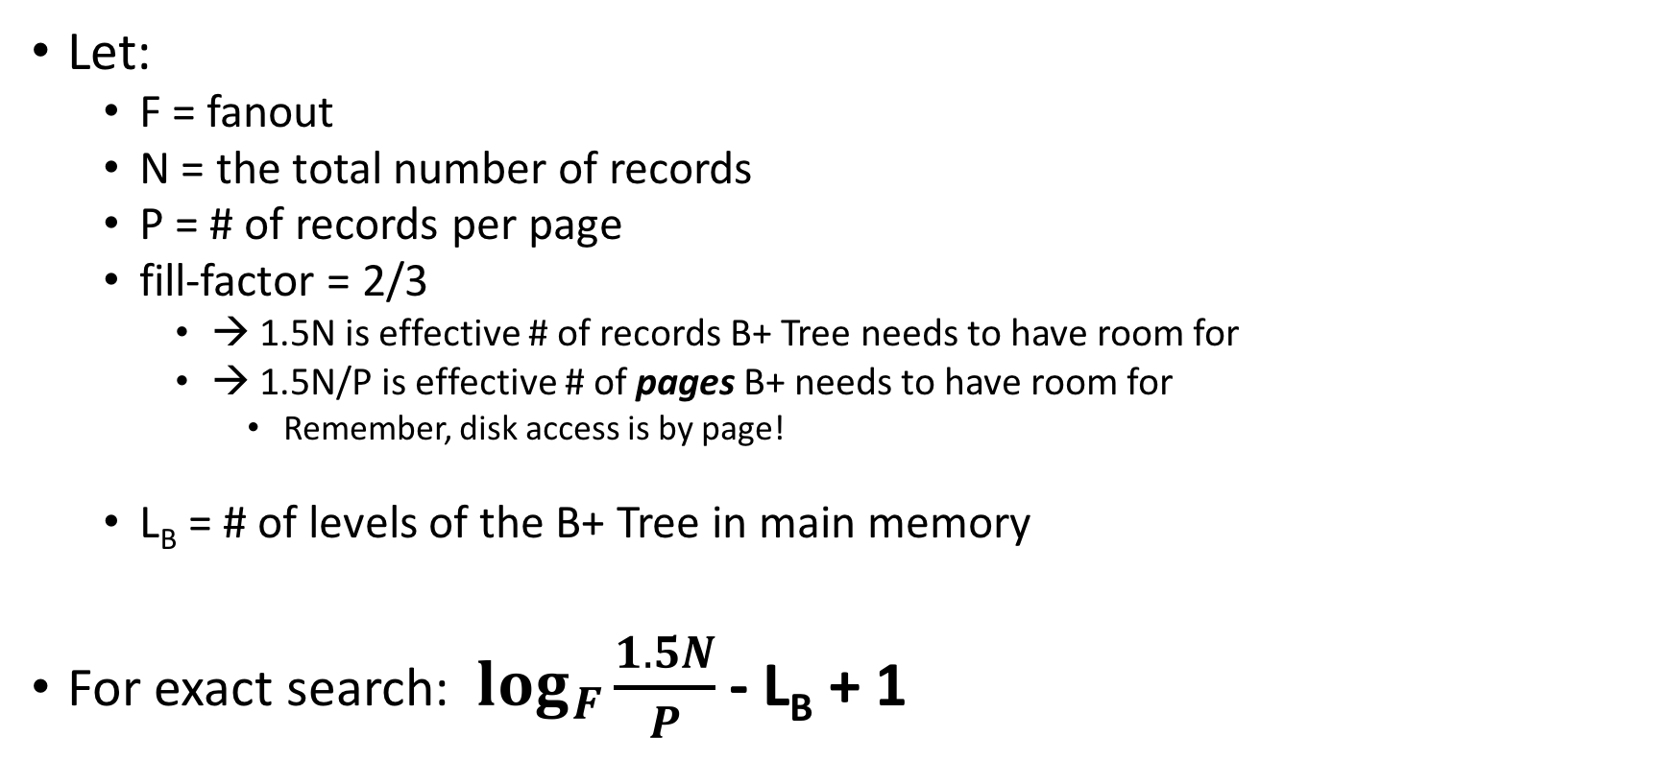
Simple Cost Model for Search
Lecture 14 > Section 1 > B+ Tree design & cost
Let:
F = fanout
N = the total number of records
P = # of records per page
fill-factor = 2/3
→ 1.5N is effective # of records B+ Tree needs to have room for
→ 1.5N/P is effective # of pages B+ needs to have room for
Remember, disk access is by page!
L_{B} = # of levels of the B+ Tree in main memory
For exact search: $\log_{F}{\frac{1.5N}{P}}$ - L_{B} + 1
Only pay for reading from B+ Tree nodes on disk (plus reading the actual record page)

Slide 23
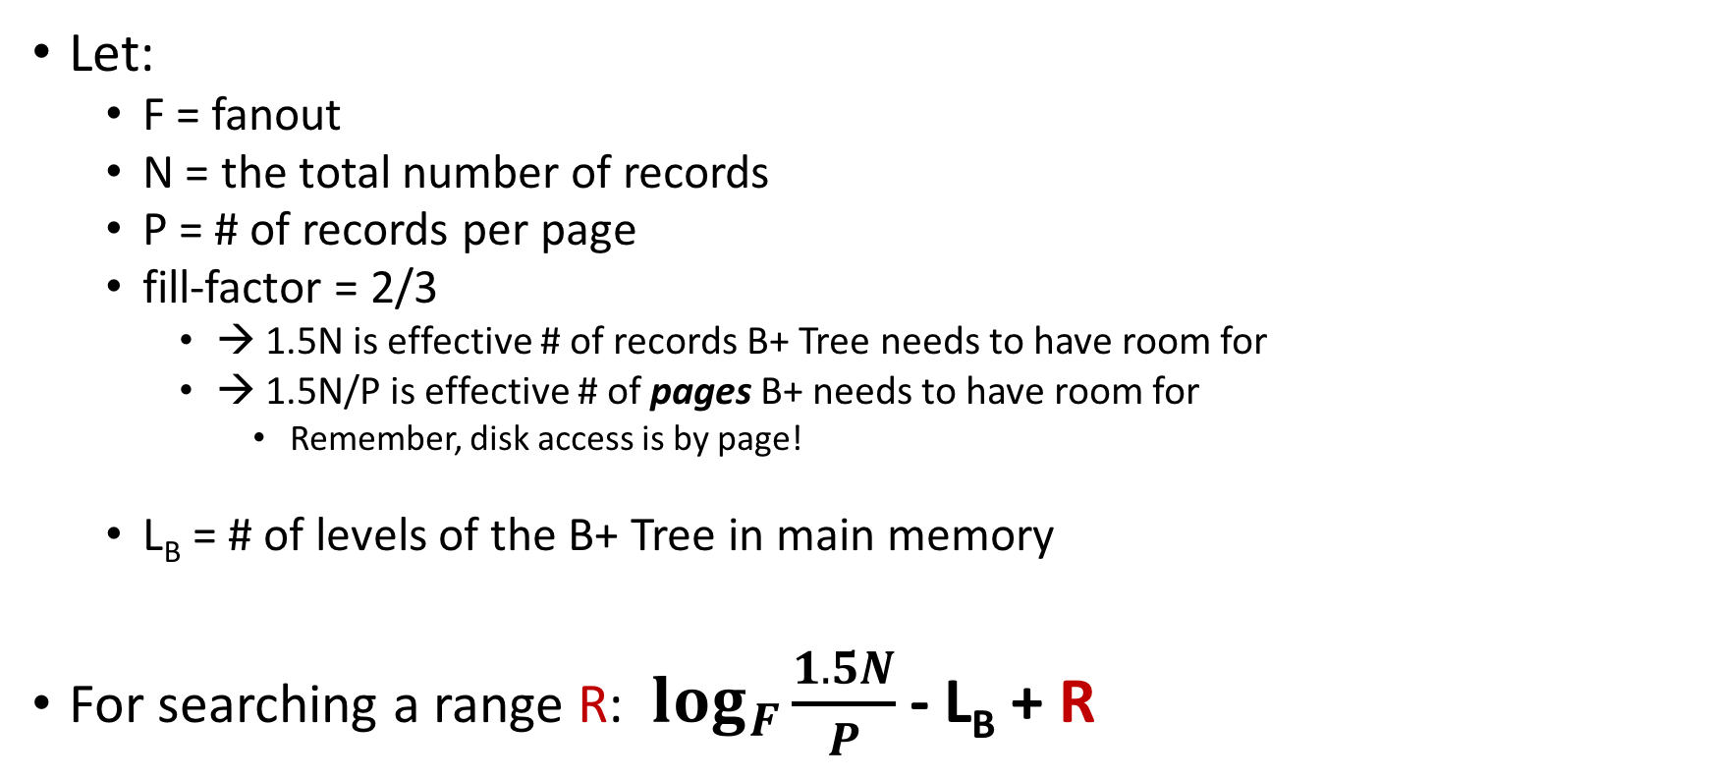
Simple Cost Model for Search
Lecture 14 > Section 1 > B+ Tree design & cost
Let:
F = fanout
N = the total number of records
P = # of records per page
fill-factor = 2/3
→ 1.5N is effective # of records B+ Tree needs to have room for
→ 1.5N/P is effective # of pages B+ needs to have room for
Remember, disk access is by page!
L_{B} = # of levels of the B+ Tree in main memory
For searching a range R: $\log_{F}{\frac{1.5N}{P}}$ - L_{B} + R
Only pay for reading from B+ Tree nodes on disk (plus reading the actual record page)

Slide 24
Fast Insertions & Self-Balancing
Lecture 14 > Section 1 > B+ Tree design & cost
We won’t go into specifics of B+ Tree insertion algorithm, but has several attractive qualities:
~ Same cost as exact search
Self-balancing: B+ Tree remains balanced (with respect to height) even after insert
B+ Trees also (relatively) fast for single insertions!
However, can become bottleneck if many insertions (if fill-factor slack is used up…)

Slide 25
Clustered Indexes
Lecture 14 > Section 1 > Clustered Indexes
An index is clustered if the underlying data is ordered in the same way as the index’s data entries.
Notes:
11

Slide 26
Clustered vs. Unclustered Index
Lecture 14 > Section 1 > Clustered Indexes
30
30
Index Entries
22 |  | 25 |  | 28 |  | 29
32 |  | 34 |  | 37 |  | 38
22 |  | 25 |  | 28 |  | 29
32 |  | 34 |  | 37 |  | 38
19
22
27
28
30
33
35
37
19
33
27
22
37
28
35
30
Data Records
Clustered
Unclustered

Slide 27
Clustered vs. Unclustered Index
Lecture 14 > Section 1 > Clustered Indexes
Recall that for a disk with block access, sequential IO is much faster than random IO
For exact search, no difference between clustered / unclustered
For range search over R values: difference between 1 random IO + R sequential IO, and R random IO:
A random IO costs ~ 10ms (sequential much much faster)
For R = 100,000 records- difference between ~10ms and ~17min!

Slide 28
Summary [From Lecture 13 too…]
Lecture 14 > Section 1 > SUMMARY
We covered an algorithm + some optimizations for sorting larger-than-memory files efficiently
An IO aware algorithm!
We create indexes over tables in order to support fast (exact and range) search and insertion over multiple search keys
B+ Trees are one index data structure which support very fast exact and range search & insertion via high fanout
Clustered vs. unclustered makes a big difference for range queries too

Slide 29
2. Nested Loop Joins
Lecture 14 > Section 2

Slide 30
What you will learn about in this section
Lecture 14 > Section 2
RECAP: Joins
Nested Loop Join (NLJ)
Block Nested Loop Join (BNLJ)
Index Nested Loop Join (INLJ)

Slide 31
RECAP: Joins
Lecture 14 > Section 2 > Joins

Slide 32
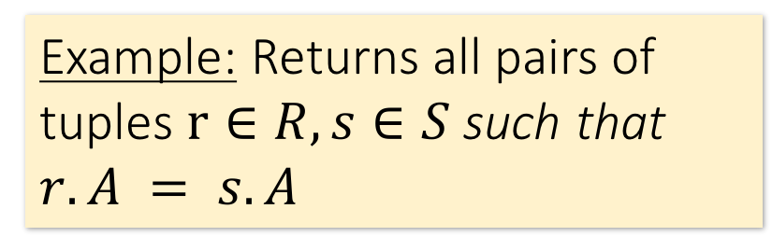

Joins: Example
Lecture 14 > Section 2 > Joins
$R⋈S$
SELECT R.A,B,C,D FROM R, S
WHERE R.A = S.A
Example: Returns all pairs of tuples $r∈R, s∈S$such that $r.A = s.A$
R
S
A | B | C
1 | 0 | 1
2 | 3 | 4
2 | 5 | 2
3 | 1 | 1
A | D
3 | 7
2 | 2
2 | 3
A | B | C | D
2 | 3 | 4 | 2

Slide 33
Joins: Example
Lecture 14 > Section 2 > Joins
$R⋈S$
SELECT R.A,B,C,D FROM R, S
WHERE R.A = S.A
Example: Returns all pairs of tuples $r∈R, s∈S$such that $r.A = s.A$
R
S
A | B | C
1 | 0 | 1
2 | 3 | 4
2 | 5 | 2
3 | 1 | 1
A | D
3 | 7
2 | 2
2 | 3
A | B | C | D
2 | 3 | 4 | 2
2 | 3 | 4 | 3

Slide 34
Joins: Example
Lecture 14 > Section 2 > Joins
$R⋈S$
SELECT R.A,B,C,D FROM R, S
WHERE R.A = S.A
Example: Returns all pairs of tuples $r∈R, s∈S$such that $r.A = s.A$
R
S
A | B | C
1 | 0 | 1
2 | 3 | 4
2 | 5 | 2
3 | 1 | 1
A | D
3 | 7
2 | 2
2 | 3
A | B | C | D
2 | 3 | 4 | 2
2 | 3 | 4 | 3
2 | 5 | 2 | 2

Slide 35
Joins: Example
Lecture 14 > Section 2 > Joins
$R⋈S$
SELECT R.A,B,C,D FROM R, S
WHERE R.A = S.A
Example: Returns all pairs of tuples $r∈R, s∈S$such that $r.A = s.A$
R
S
A | B | C
1 | 0 | 1
2 | 3 | 4
2 | 5 | 2
3 | 1 | 1
A | D
3 | 7
2 | 2
2 | 3
A | B | C | D
2 | 3 | 4 | 2
2 | 3 | 4 | 3
2 | 5 | 2 | 2
2 | 5 | 2 | 3

Slide 36
Joins: Example
Lecture 14 > Section 2 > Joins
$R⋈S$
SELECT R.A,B,C,D FROM R, S
WHERE R.A = S.A
Example: Returns all pairs of tuples $r∈R, s∈S$such that $r.A = s.A$
R
S
A | B | C
1 | 0 | 1
2 | 3 | 4
2 | 5 | 2
3 | 1 | 1
A | D
3 | 7
2 | 2
2 | 3
A | B | C | D
2 | 3 | 4 | 2
2 | 3 | 4 | 3
2 | 5 | 2 | 2
2 | 5 | 2 | 3
3 | 1 | 1 | 7

Slide 37

Semantically: A Subset of the Cross Product
Lecture 14 > Section 2 > Joins
$R⋈S$
SELECT R.A,B,C,D FROM R, S
WHERE R.A = S.A
Example: Returns all pairs of tuples $r∈R, s∈S$such that $r.A = s.A$
R
S
A | B | C | D
2 | 3 | 4 | 2
2 | 3 | 4 | 3
2 | 5 | 2 | 2
2 | 5 | 2 | 3
3 | 1 | 1 | 7
A | B | C
1 | 0 | 1
2 | 3 | 4
2 | 5 | 2
3 | 1 | 1
A | D
3 | 7
2 | 2
2 | 3
…
$$×$$
Can we actually implement a join in this way?
Cross Product
Filter by conditions
(r.A = s.A)

Slide 38
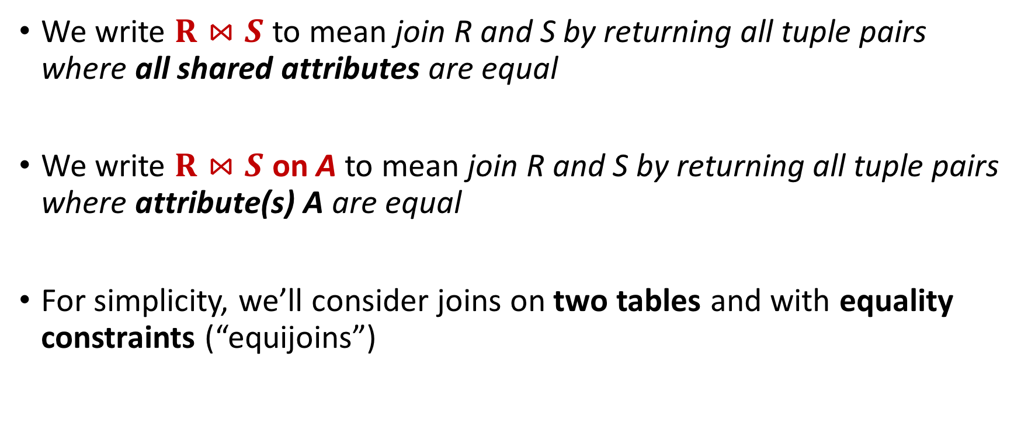
Notes
Lecture 14 > Section 2 > Joins
We write $R⋈S$ to mean join R and S by returning all tuple pairs where all shared attributes are equal
We write $R⋈S$ on A to mean join R and S by returning all tuple pairs where attribute(s) A are equal
For simplicity, we’ll consider joins on two tables and with equality constraints (“equijoins”)
However joins can merge > 2 tables, and some algorithms do support non-equality constraints!

Slide 39
Nested Loop Joins
Lecture 14 > Section 2 > NLJ

Slide 40
Notes
Lecture 14 > Section 2 > NLJ
We are again considering “IO aware” algorithms: care about disk IO
Given a relation R, let:
T(R) = # of tuples in R
P(R) = # of pages in R
Note also that we omit ceilings in calculations… good exercise to put back in!
Recall that we read / write entire pages with disk IO

Slide 41
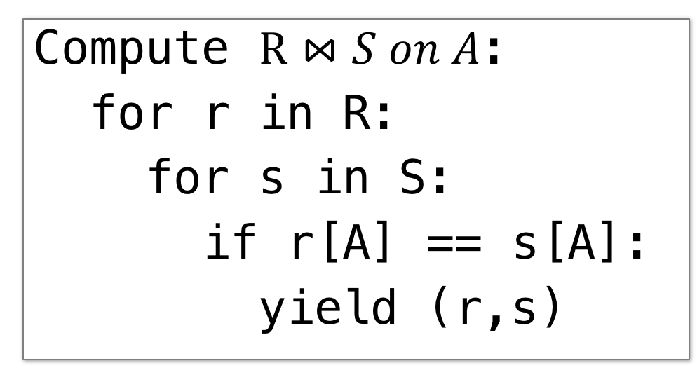
Nested Loop Join (NLJ)
Lecture 14 > Section 2 > NLJ
Compute $R⋈S on A$:
for r in R:
for s in S:
if r[A] == s[A]:
yield (r,s)

Slide 42
Nested Loop Join (NLJ)
Lecture 14 > Section 2 > NLJ
Cost:
Compute $R⋈S on A$:
for r in R:
for s in S:
if r[A] == s[A]:
yield (r,s)
P(R)
Loop over the tuples in R
Note that our IO cost is based on the number of pages loaded, not the number of tuples!

Slide 43
Nested Loop Join (NLJ)
Lecture 14 > Section 2 > NLJ
Cost:
Compute $R⋈S on A$:
for r in R:
for s in S:
if r[A] == s[A]:
yield (r,s)
P(R) + T(R)*P(S)
Loop over the tuples in R
For every tuple in R, loop over all the tuples in S
Have to read all of S from disk for every tuple in R!

Slide 44
Nested Loop Join (NLJ)
Lecture 14 > Section 2 > NLJ
Cost:
Compute $R⋈S on A$:
for r in R:
for s in S:
if r[A] == s[A]:
yield (r,s)
P(R) + T(R)*P(S)
Loop over the tuples in R
For every tuple in R, loop over all the tuples in S
Check against join conditions
Note that NLJ can handle things other than equality constraints… just check in the if statement!

Slide 45
Nested Loop Join (NLJ)
Lecture 14 > Section 2 > NLJ
Cost:
Compute $R⋈S on A$:
for r in R:
for s in S:
if r[A] == s[A]:
yield (r,s)
P(R) + T(R)*P(S) + OUT
Loop over the tuples in R
For every tuple in R, loop over all the tuples in S
Check against join conditions
Write out (to page, then when page full, to disk)
What would OUT be if our join condition is trivial (if TRUE)?
OUT could be bigger than P(R)*P(S)… but usually not that bad

Slide 46
Nested Loop Join (NLJ)
Lecture 14 > Section 2 > NLJ
Cost:
Compute $R⋈S on A$:
for r in R:
for s in S:
if r[A] == s[A]:
yield (r,s)
P(R) + T(R)*P(S) + OUT
What if R (“outer”) and S (“inner”) switched?
P(S) + T(S)*P(R) + OUT
Outer vs. inner selection makes a huge difference- DBMS needs to know which relation is smaller!

Slide 47
IO-Aware Approach
Lecture 14 > Section 2 > BNLJ

Slide 48
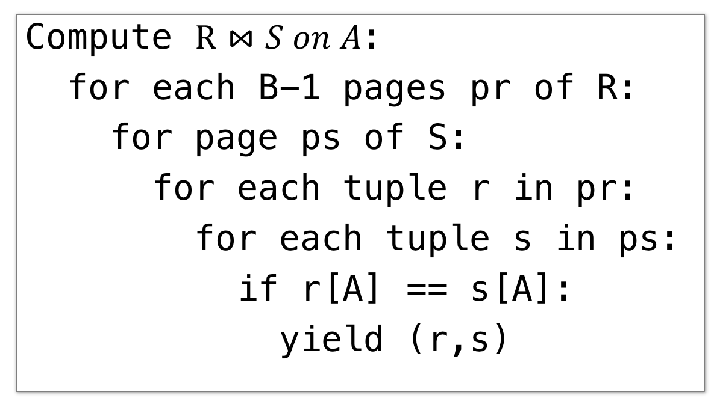
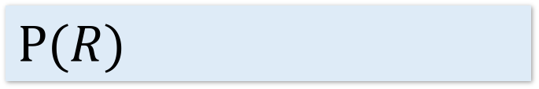
Block Nested Loop Join (BNLJ)
Lecture 14 > Section 2 > BNLJ
Given B+1 pages of memory
Cost:
Compute $R⋈S on A$:
for each B-1 pages pr of R:
for page ps of S:
for each tuple r in pr:
for each tuple s in ps:
if r[A] == s[A]:
yield (r,s)
$$P(R)$$
Load in B-1 pages of R at a time (leaving 1 page each free for S & output)
Note: There could be some speedup here due to the fact that we’re reading in multiple pages sequentially however we’ll ignore this here!

Slide 49
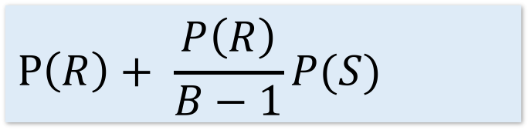
Block Nested Loop Join (BNLJ)
Lecture 14 > Section 2 > BNLJ
Given B+1 pages of memory
Cost:
Compute $R⋈S on A$:
for each B-1 pages pr of R:
for page ps of S:
for each tuple r in pr:
for each tuple s in ps:
if r[A] == s[A]:
yield (r,s)
$$P\left(R\right)+ \frac{P\left(R\right)}{B−1}P(S)$$
Load in B-1 pages of R at a time (leaving 1 page each free for S & output)
For each (B-1)-page segment of R, load each page of S
Note: Faster to iterate over the smaller relation first!

Slide 50
Block Nested Loop Join (BNLJ)
Lecture 14 > Section 2 > BNLJ
Given B+1 pages of memory
Cost:
Compute $R⋈S on A$:
for each B-1 pages pr of R:
for page ps of S:
for each tuple r in pr:
for each tuple s in ps:
if r[A] == s[A]:
yield (r,s)
$$P\left(R\right)+ \frac{P\left(R\right)}{B−1}P(S)$$
Load in B-1 pages of R at a time (leaving 1 page each free for S & output)
For each (B-1)-page segment of R, load each page of S
Check against the join conditions
BNLJ can also handle non-equality constraints

Slide 51
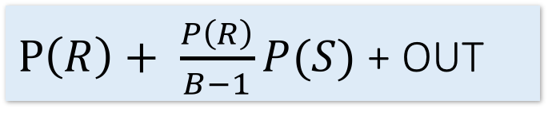
Block Nested Loop Join (BNLJ)
Lecture 14 > Section 2 > BNLJ
Given B+1 pages of memory
Cost:
Compute $R⋈S on A$:
for each B-1 pages pr of R:
for page ps of S:
for each tuple r in pr:
for each tuple s in ps:
if r[A] == s[A]:
yield (r,s)
$P\left(R\right)+ \frac{P\left(R\right)}{B−1}P(S)$ + OUT
Load in B-1 pages of R at a time (leaving 1 page each free for S & output)
For each (B-1)-page segment of R, load each page of S
Check against the join conditions
Write out
Again, OUT could be bigger than P(R)*P(S)… but usually not that bad

Slide 52
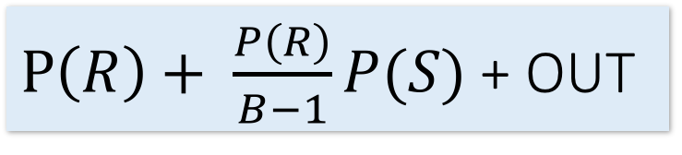
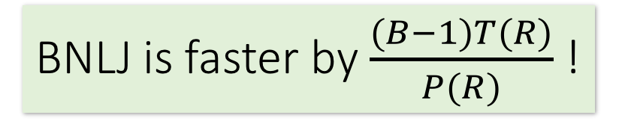
BNLJ vs. NLJ: Benefits of IO Aware
Lecture 14 > Section 2 > BNLJ
In BNLJ, by loading larger chunks of R, we minimize the number of full disk reads of S
We only read all of S from disk for every (B-1)-page segment of R!
Still the full cross-product, but more done only in memory
NLJ
BNLJ
P(R) + T(R)*P(S) + OUT
$P\left(R\right)+ \frac{P\left(R\right)}{B−1}P(S)$ + OUT
BNLJ is faster by $\frac{(B−1)T(R)}{P(R)}$ !

Slide 53
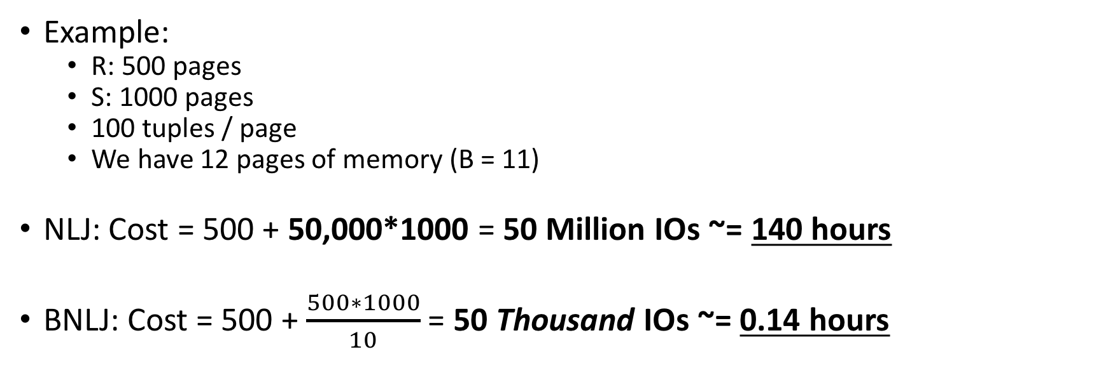
BNLJ vs. NLJ: Benefits of IO Aware
Lecture 14 > Section 2 > BNLJ
Example:
R: 500 pages
S: 1000 pages
100 tuples / page
We have 12 pages of memory (B = 11)
NLJ: Cost = 500 + 50,000*1000 = 50 Million IOs ~= 140 hours
BNLJ: Cost = 500 + $\frac{500∗1000}{10}$ = 50 Thousand IOs ~= 0.14 hours
Ignoring OUT here…
A very real difference from a small change in the algorithm!

Slide 54
Smarter than Cross-Products
Lecture 14 > Section 2 > INLJ

Slide 55
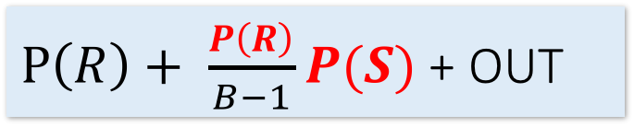
Smarter than Cross-Products: From Quadratic to Nearly Linear
Lecture 14 > Section 2 > INLJ
All joins that compute the full cross-product have some quadratic term
For example we saw:
Now we’ll see some (nearly) linear joins:
~ O(P(R) + P(S) + OUT), where again OUT could be quadratic but is usually better
NLJ
P(R) + T(R)P(S) + OUT
$P\left(R\right)+ \frac{P\left(R\right)}{B−1}P(S)$ + OUT
BNLJ
We get this gain by taking advantage of structure- moving to equality constraints (“equijoin”) only!

Slide 56
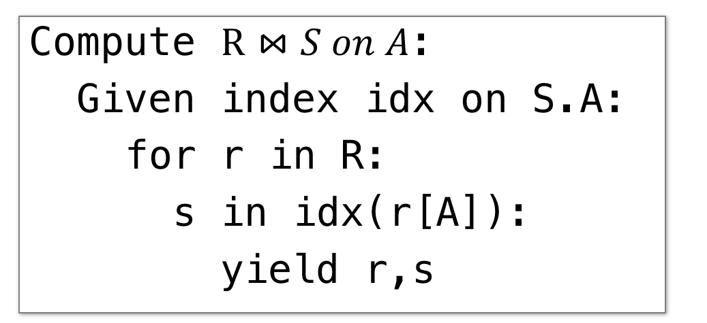
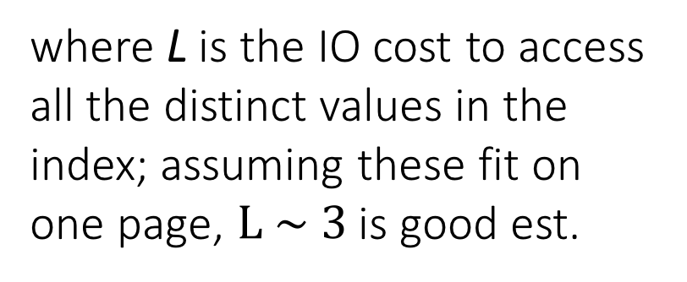
Index Nested Loop Join (INLJ)
Lecture 14 > Section 2 > INLJ
Cost:
Compute $R⋈S on A$:
Given index idx on S.A:
for r in R:
s in idx(r[A]):
yield r,s
P(R) + T(R)*L + OUT
where L is the IO cost to access all the distinct values in the index; assuming these fit on one page, $L \sim 3$ is good est.
→ We can use an index (e.g. B+ Tree) to avoid doing the full cross-product!

Slide 57
Lecture 15: Joins- A Cage Match
Lecture 15

Slide 58
Today’s Lecture
Lecture 15
Sort-Merge Join (SMJ)
Hash Join (HJ)
The Cage Match: SMJ vs. HJ

Slide 59

1. Sort-Merge Join (SMJ)
Lecture 15 > Section 1

Slide 60
What you will learn about in this section
Lecture 15 > Section 1
Sort-Merge Join
“Backup” & Total Cost
Optimizations
ACTIVITY: Sequential Flooding

Slide 61
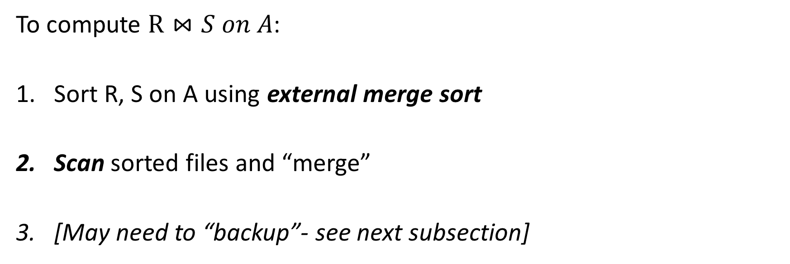
Sort Merge Join (SMJ): Basic Procedure
Lecture 15 > Section 1 > SMJ
To compute $R⋈S on A$:
Sort R, S on A using external merge sort
Scan sorted files and “merge”
[May need to “backup”- see next subsection]
Note that we are only considering equality constraints here
Note that if R, S are already sorted on A, SMJ will be awesome!

Slide 62

SMJ Example: $R⋈S on A$with 3 page buffer
Lecture 15 > Section 1 > SMJ
For simplicity: Let each page be one tuple, and let the first value be A
We show the file HEAD, which is the next value to be read!
Disk
Main Memory
R
(0,a)
(5,b)
(3,j)
Buffer
S
(3,g)
(7,f)
(0,j)

Slide 63
SMJ Example: $R⋈S on A$with 3 page buffer
Lecture 15 > Section 1 > SMJ
1. Sort the relations R, S on the join key (first value)
Disk
Main Memory
(3,j)
(5,b)
(5,b)
(0,a)
(3,j)
R
(0,a)
Buffer
S
(7,f)
(3,g)
(0,j)
(0,j)
(7,f)
(3,g)

Slide 64
SMJ Example: $R⋈S on A$with 3 page buffer
Lecture 15 > Section 1 > SMJ
2. Scan and “merge” on join key!
Disk
Main Memory
(0,a)
(3,j)
(5,b)
R
(0,a)
Buffer
S
(0,j)
(3,g)
(7,f)
(0,j)
Output

Slide 65
SMJ Example: $R⋈S on A$with 3 page buffer
Lecture 15 > Section 1 > SMJ
2. Scan and “merge” on join key!
Disk
Main Memory
R
(0,a)
(3,j)
(5,b)
Buffer
S
(0,j)
(3,g)
(7,f)
(0,a)
(0,j)
(0,a,j)
Output

Slide 66
SMJ Example: $R⋈S on A$with 3 page buffer
Lecture 15 > Section 1 > SMJ
2. Scan and “merge” on join key!
Disk
Main Memory
(0,a)
(3,j)
(5,b)
R
(3,j)
(5,b)
Buffer
S
(0,j)
(3,g)
(7,f)
(3,g)
(7,f)
(3,j,g)
Output
(0,a,j)

Slide 67
SMJ Example: $R⋈S on A$with 3 page buffer
Lecture 15 > Section 1 > SMJ
2. Done!
Disk
Main Memory
(0,a)
3,j
5,b
R
(3,j)
(5,b)
Buffer
S
(0,j)
3,g
7,f
(3,g)
(7,f)
Output
(0,a,j)
(3,j,g)

Slide 68
What happens with duplicate join keys?
Lecture 15 > Section 1 > Backup

Slide 69
Multiple tuples with Same Join Key: “Backup”
Lecture 15 > Section 1 > Backup
1. Start with sorted relations, and begin scan / merge…
Disk
Main Memory
(0,a)
3,j
5,b
R
(0,a)
(0,j)
(0,b)
Buffer
S
(0,j)
(0,j)
3,g
7,f
(0,g)
(7,f)
Output

Slide 70
Multiple tuples with Same Join Key: “Backup”
Lecture 15 > Section 1 > Backup
1. Start with sorted relations, and begin scan / merge…
Disk
Main Memory
(0,a)
3,j
5,b
R
(0,j)
(0,b)
Buffer
S
(0,j)
3,g
7,f
(0,g)
(7,f)
(0,a)
(0,j)
(0,a,j)
Output

Slide 71
Multiple tuples with Same Join Key: “Backup”
Lecture 15 > Section 1 > Backup
1. Start with sorted relations, and begin scan / merge…
Disk
Main Memory
(0,a)
(0,j)
5,b
R
(0,j)
(0,b)
Buffer
S
(0,j)
(0,g)
7,f
(0,g)
(7,f)
(0,a)
(0,a,g)
Output
(0,a,j)

Slide 72
Multiple tuples with Same Join Key: “Backup”
Lecture 15 > Section 1 > Backup
1. Start with sorted relations, and begin scan / merge…
Disk
Main Memory
(0,a)
0,j
5,b
R
(0,j)
(0,b)
Buffer
S
(0,j)
0,g
7,f
(0,j)
(0,g)
(7,f)
(0,j)
Output
(0,a,j)
(0,a,g)
Have to “backup” in the scan of S and read tuple we’ve already read!

Slide 73
Backup
Lecture 15 > Section 1 > Backup
At best, no backup → scan takes O(P(R) + P(S)) reads
For ex: if no duplicate values in join attribute
At worst (e.g. full backup each time), scan takes O(P(R) * P(S)) reads
Often not that bad, plus we can:
Leave more data in buffer (for larger buffers)
Can “zig-zag” (see animation)

Slide 74
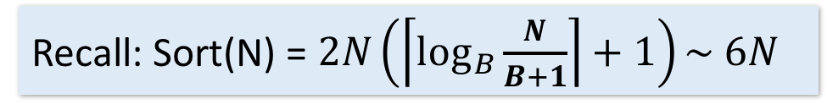
SMJ: Total cost
Lecture 15 > Section 1 > Backup
Cost of SMJ is cost of sorting R and S…
Plus the cost of scanning: ~P(R)+P(S)
Because of backup: in worst case P(R)*P(S); but this would be very unlikely
Plus the cost of writing out: ~P(R)+P(S) but in worst case > P(R)*P(S)
~ Sort(P(R)) + Sort(P(S)) + P(R) + P(S) + OUT
Recall: Sort(N) = $2N\left(\left\lceil \log_{B}{\frac{N}{B+1}}\right\rceil +1\right)\sim 6N$

Slide 75
SMJ vs. BNLJ: Steel Cage Match
Lecture 15 > Section 1 > Backup
If we have 100 buffer pages, P(R) = 1000 pages and P(S) = 500 pages:
Sort both in two passes: 2 * 2 * 1000 + 2 * 2 * 500 = 6000 IOs
Merge phase 1000 + 500 = 1500 IOs
= 7500 IOs
What is BNLJ?
500 + 1000*500/99 = 5550 IOs
But, if we have 35 buffer pages?
Sort Merge has same behavior (still 2 passes)
BNLJ? ~ 15,000 IOs!
SMJ is ~ linear vs. BNLJ is quadratic…

Slide 76
A Simple Optimization: Merges Merged!
Lecture 15 > Section 1 > Backup
Given B+1 buffer pages
SMJ is composed of a sort phase and a merge phase
During the sort phase, we run passes of external merge sort on R and S
Suppose at some point, R and S have <= B (sorted) runs in total
We could do two B/2-way merges at this point, complete the sort phase, and start the merge phase…
OR, we could combine them: do one B-way merge and complete the join!

Slide 77
Un-Optimized SMJ
Lecture 15 > Section 1 > Backup
Given B+1 buffer pages
Unsorted input relations
Sort Phase
(Ext. Merge Sort)
R
S
Split & sort
Split & sort
Merge
Merge
Merge
Merge
Merge / Join Phase
Joined output file created!

Slide 78
Simple SMJ Optimization
Lecture 15 > Section 1 > Backup
Given B+1 buffer pages
Unsorted input relations
Sort Phase
(Ext. Merge Sort)
R
S
Split & sort
Split & sort
Merge
Merge
<= B total runs
B-Way Merge / Join
Merge / Join Phase
Joined output file created!

Slide 79
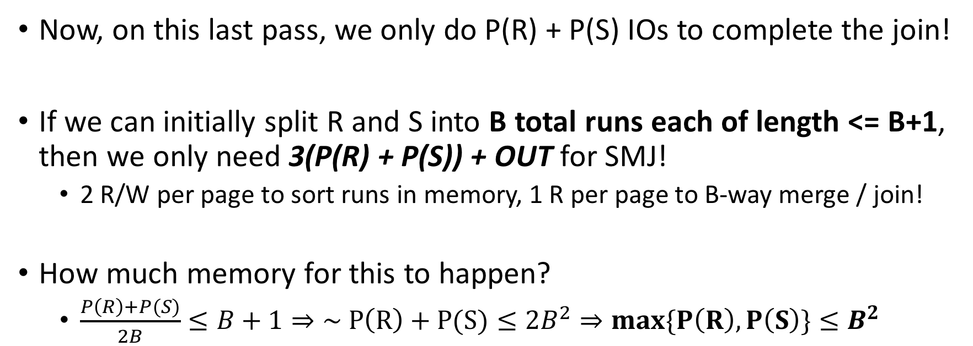
Simple SMJ Optimization
Lecture 15 > Section 1 > Backup
Given B+1 buffer pages
Now, on this last pass, we only do P(R) + P(S) IOs to complete the join!
If we can initially split R and S into B total runs each of length <= B+1, then we only need 3(P(R) + P(S)) + OUT for SMJ!
2 R/W per page to sort runs in memory, 1 R per page to B-way merge / join!
How much memory for this to happen?
$\frac{P\left(R\right)+P(S)}{2B}≤B+1⇒\sim P\left(R\right)+P(S)≤2B^{2}⇒max\{P\left(R\right), P\left(S\right)\}≤B^{2}$
If the larger of R,S has <= B² pages, then SMJ costs 3(P(R)+P(S)) + OUT!

Slide 80
Takeaway points from SMJ
Lecture 15 > Section 1 > Summary
If input already sorted on join key, skip the sorts.
SMJ is basically linear.
Nasty but unlikely case: Many duplicate join keys.
SMJ needs to sort both relations
If max { P(R), P(S) } < B² then cost is 3(P(R)+P(S)) + OUT

Slide 81
Activity-14.ipynb
Lecture 15 > Section 1 > ACTIVITY

Slide 82

4. Hash Join (HJ)
Lecture 15 > Section 2

Slide 83
What you will learn about in this section
Lecture 15 > Section 2
Hash Join
Memory requirements

Slide 84
Recall: Hashing
Lecture 15 > Section 2 > HJ
Magic of hashing:
A hash function maps h_{B} maps into [0,B-1]
And maps nearly uniformly
A hash collision is when x != y but h_{B}(x) = h_{B}(y)
Note however that it will never occur that x = y but h_{B}(x) != h_{B}(y)
We hash on an attribute A, so our has function is h_{B}(t) has the form h_{B}(t.A).
Collisions may be more frequent.

Slide 85
Recall: Mad Hash Collisions
Lecture 15 > Section 2 > HJ
Say something here to justify this slide’s existence? [TODO]

Slide 86
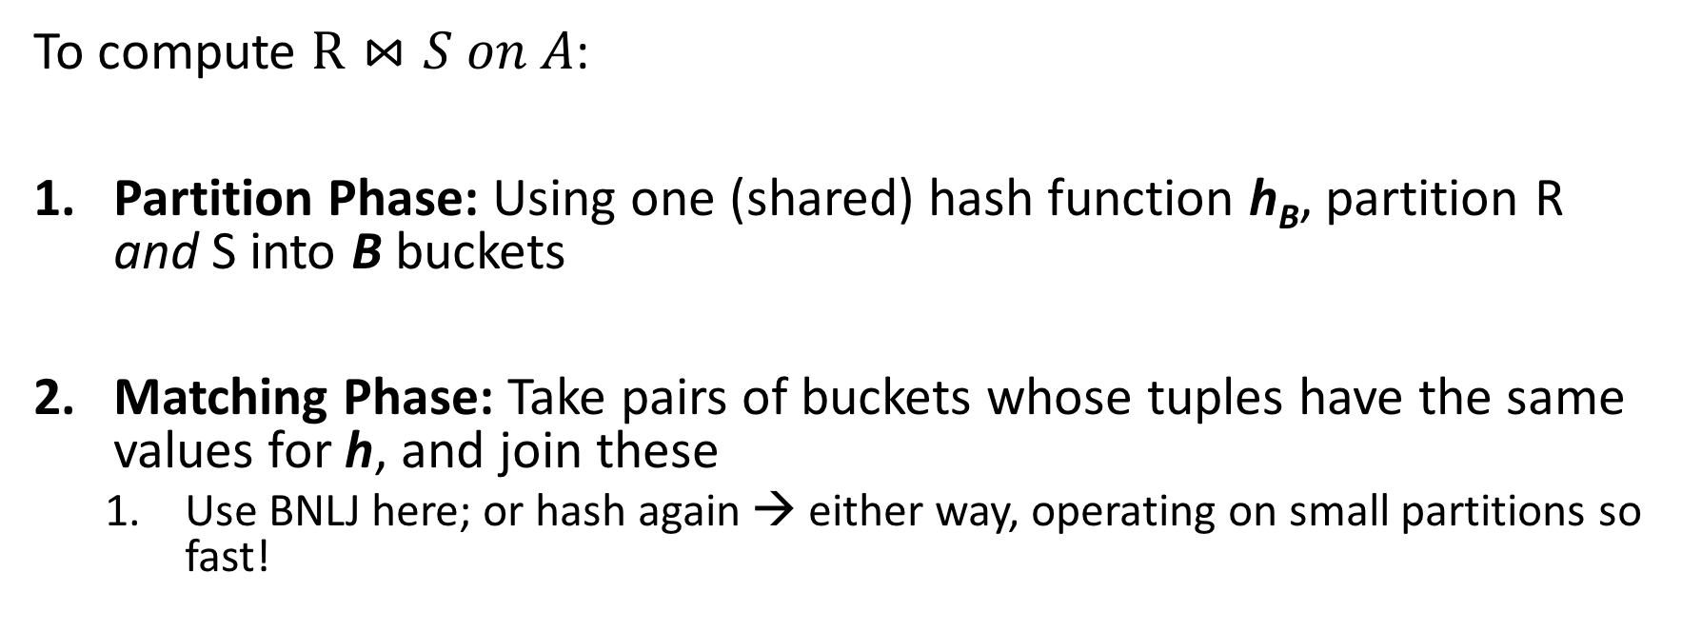
Hash Join: High-level procedure
Lecture 15 > Section 2 > HJ
Note again that we are only considering equality constraints here
To compute $R⋈S on A$:
Partition Phase: Using one (shared) hash function h_{B}, partition R and S into B buckets
Matching Phase: Take pairs of buckets whose tuples have the same values for h, and join these
Use BNLJ here; or hash again → either way, operating on small partitions so fast!
We decompose the problem using h_{B}, then complete the join

Slide 87
Hash Join: High-level procedure
Lecture 15 > Section 2 > HJ
1. Partition Phase: Using one (shared) hash function h_{B}, partition R and S into B buckets
Disk
Disk
Note our new convention: pages each have two tuples (one per row)
(0,a)
(0,a)
(0,j)
R
(0,a)
(0,a)
(3,j)
(0,j)
(3,b)
R₁
h_{B}
R₂
(3,b)
(3,j)
S
(0,a)
(0,j)
(5,b)
S₁
(0,a)
(0,j)
More detail in a second…
S₂
(5,b)
(5,b)

Slide 88
Hash Join: High-level procedure
Lecture 15 > Section 2 > HJ
2. Matching Phase: Take pairs of buckets whose tuples have the same values for h_{B}, and join these
Disk
Disk
(0,a)
(0,a)
(0,j)
R
(0,a)
(0,a)
(3,j)
(0,j)
(3,b)
R₁
h_{B}
Join matching buckets
R₂
(3,b)
S
(0,a)
(0,j)
(5,b)
S₁
(0,a)
(0,j)
S₂
(5,b)
(5,b)

Slide 89
Hash Join: High-level procedure
Lecture 15 > Section 2 > HJ
2. Matching Phase: Take pairs of buckets whose tuples have the same values for h_{B}, and join these
Disk
Disk
(0,a)
(0,a)
(0,j)
R
(0,a)
(0,a)
(3,j)
(0,j)
(3,b)
R₁
h_{B}
(3,b)
Don’t have to join the others! E.g. these!
R₂
S
(0,a)
(0,j)
(5,b)
S₁
(0,a)
(0,j)
S₂
(5,b)
(5,b)

Slide 90
Hash Join Phase 1: Partitioning
Lecture 15 > Section 2 > HJ
Goal: For each relation, partition relation into buckets such that if h_{B}(t.A) = h_{B}(t’.A) they are in the same bucket
Given B+1 buffer pages, we partition into B buckets:
We use B buffer pages for output (one for each bucket), and 1 for input
The “dual” of sorting.
For each tuple t in input, copy to buffer page for h_{B}(t.A)
When page fills up, flush to disk.

Slide 91
How big are the resulting buckets?
Lecture 15 > Section 2 > HJ
Given B+1 buffer pages
Given N input pages, we partition into B buckets:
→ Ideally our buckets are each of size ~ N/B pages
What happens if there are hash collisions?
Buckets could be > N/B
We’ll do several passes…
What happens if there are duplicate join keys?
Nothing we can do here… could have some skew in size of the buckets

Slide 92
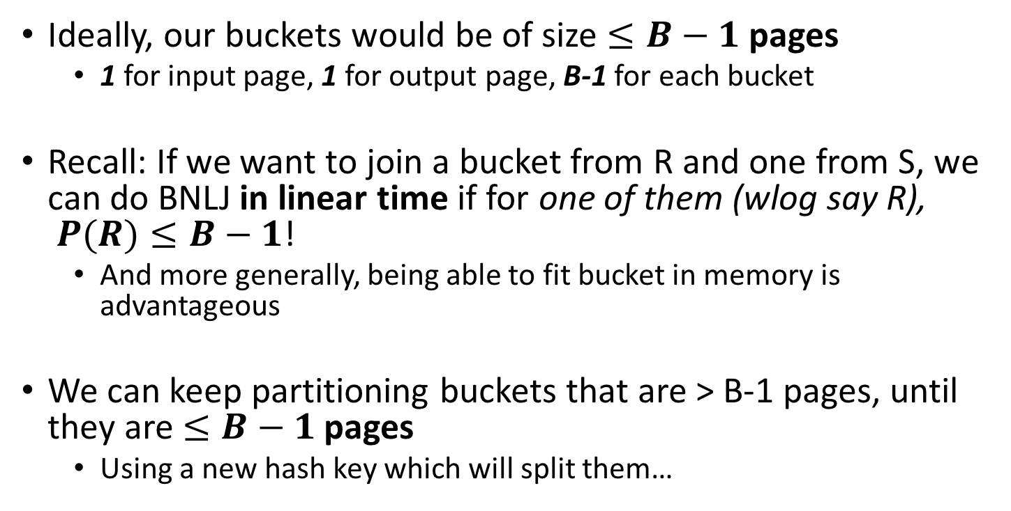
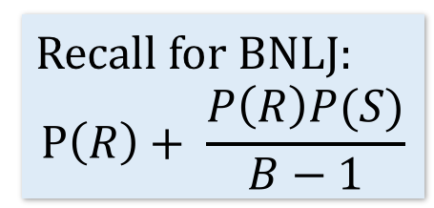
How big do we want the resulting buckets?
Lecture 15 > Section 2 > HJ
Given B+1 buffer pages
Ideally, our buckets would be of size $≤B−1$ pages
1 for input page, 1 for output page, B-1 for each bucket
Recall: If we want to join a bucket from R and one from S, we can do BNLJ in linear time if for one of them (wlog say R), $P(R)≤B−1$!
And more generally, being able to fit bucket in memory is advantageous
We can keep partitioning buckets that are > B-1 pages, until they are $≤B−1$ pages
Using a new hash key which will split them…
Recall for BNLJ:
$$P\left(R\right)+ \frac{P\left(R\right)P(S)}{B−1}$$
We’ll call each of these a “pass” again…

Slide 93
Hash Join Phase 1: Partitioning
Lecture 15 > Section 2 > HJ
Given B+1 = 3 buffer pages
We partition into B = 2 buckets using hash function h₂ so that we can have one buffer page for each partition (and one for input)
Disk
For simplicity, we’ll look at partitioning one of the two relations- we just do the same for the other relation!
(5,b)
(5,a)
(0,j)
(3,j)
(0,j)
R
(0,a)
(3,a)
Recall: our goal will be to get B = 2 buckets of size <= B-1 → 1 page each

Slide 94
Hash Join Phase 1: Partitioning
Lecture 15 > Section 2 > HJ
Given B+1 = 3 buffer pages
1. We read pages from R into the “input” page of the buffer…
Disk
Main Memory
(5,b)
(5,a)
(0,j)
(3,j)
(0,j)
R
Buffer
(0,a)
(3,a)
Input page
0
1
Output (bucket) pages

Slide 95
Hash Join Phase 1: Partitioning
Lecture 15 > Section 2 > HJ
Given B+1 = 3 buffer pages
2. Then we use hash function h₂ to sort into the buckets, which each have one page in the buffer
Disk
Main Memory
h₂(0) = 0
R
(5,b)
(5,a)
(0,j)
(3,j)
(0,j)
Buffer
(3,a)
(0,a)
(3,a)
(0,a)
Input page
0
1
Output (bucket) pages

Slide 96
Hash Join Phase 1: Partitioning
Lecture 15 > Section 2 > HJ
Given B+1 = 3 buffer pages
2. Then we use hash function h₂ to sort into the buckets, which each have one page in the buffer
Disk
Main Memory
h₂(3) = 1
R
(5,b)
(5,a)
(0,j)
(3,j)
(0,j)
Buffer
(3,a)
(0,a)
(3,a)
Input page
0
1
Output (bucket) pages

Slide 97
Hash Join Phase 1: Partitioning
Lecture 15 > Section 2 > HJ
Given B+1 = 3 buffer pages
3. We repeat until the buffer bucket pages are full…
Disk
Main Memory
R
(5,b)
(5,a)
(0,j)
(3,j)
(0,j)
Buffer
(0,a)
(3,a)
Input page
0
1
Output (bucket) pages

Slide 98
Hash Join Phase 1: Partitioning
Lecture 15 > Section 2 > HJ
Given B+1 = 3 buffer pages
3. We repeat until the buffer bucket pages are full…
Disk
Main Memory
h₂(3) = 1
R
(5,b)
(5,a)
(0,j)
Buffer
(3,j)
(0,j)
(3,a)
(3,j)
(0,j)
(0,a)
(3,a)
Input page
0
1
Output (bucket) pages

Slide 99
Hash Join Phase 1: Partitioning
Lecture 15 > Section 2 > HJ
Given B+1 = 3 buffer pages
3. We repeat until the buffer bucket pages are full…
Disk
Main Memory
h₂(0) = 0
R
(5,b)
(5,a)
(0,j)
Buffer
(0,a)
(0,j)
(3,a)
(3,j)
(0,j)
(0,a)
(3,a)
Input page
0
1
Output (bucket) pages

Slide 100
Hash Join Phase 1: Partitioning
Lecture 15 > Section 2 > HJ
Given B+1 = 3 buffer pages
3. We repeat until the buffer bucket pages are full… then flush to disk
Disk
Main Memory
R
(5,b)
(5,a)
(0,j)
Buffer
B0
(0,a)
(0,j)
(3,a)
(3,j)
B1
Input page
0
1
Output (bucket) pages

Slide 101
Hash Join Phase 1: Partitioning
Lecture 15 > Section 2 > HJ
Given B+1 = 3 buffer pages
3. We repeat until the buffer bucket pages are full… then flush to disk
Disk
Main Memory
R
(5,b)
(5,a)
(0,j)
Buffer
(0,a)
(0,j)
B0
(3,a)
(3,j)
Input page
B1
0
1
Output (bucket) pages

Slide 102
Hash Join Phase 1: Partitioning
Lecture 15 > Section 2 > HJ
Given B+1 = 3 buffer pages
Note that collisions can occur!
Collision!!!
Disk
Main Memory
h₂(5) = 1
R
(5,b)
Buffer
(0,a)
(0,j)
(0,j)
(5,a)
B0
(5,a)
(0,j)
(3,a)
(3,j)
Input page
B1
0
1
Output (bucket) pages

Slide 103
Hash Join Phase 1: Partitioning
Lecture 15 > Section 2 > HJ
Given B+1 = 3 buffer pages
Finish this pass…
Disk
Main Memory
h₂(0) = 0
R
(5,b)
Buffer
(0,a)
(0,j)
(0,j)
(0,j)
(5,a)
B0
(3,a)
(3,j)
Input page
B1
0
1
Output (bucket) pages

Slide 104
Hash Join Phase 1: Partitioning
Lecture 15 > Section 2 > HJ
Given B+1 = 3 buffer pages
Finish this pass…
Disk
Main Memory
R
(5,b)
Buffer
(0,a)
(0,j)
(0,j)
(5,a)
B0
(3,a)
(3,j)
Input page
B1
0
1
Output (bucket) pages

Slide 105
Hash Join Phase 1: Partitioning
Lecture 15 > Section 2 > HJ
Given B+1 = 3 buffer pages
Finish this pass…
Disk
Main Memory
h₂(5) = 1
R
Buffer
(0,a)
(0,j)
(5,b)
(0,j)
(5,a)
B0
(5,a)
(5,b)
(3,a)
(3,j)
Input page
B1
0
1
Output (bucket) pages

Slide 106
Hash Join Phase 1: Partitioning
Lecture 15 > Section 2 > HJ
Given B+1 = 3 buffer pages
Finish this pass…
Disk
Main Memory
R
Buffer
(0,a)
(0,j)
(0,j)
(5,a)
(5,b)
B0
(3,a)
(3,j)
Input page
B1
0
1
Output (bucket) pages

Slide 107
Hash Join Phase 1: Partitioning
Lecture 15 > Section 2 > HJ
Given B+1 = 3 buffer pages
We wanted buckets of size B-1 = 1… however we got larger ones due to:
Disk
(0,a)
(0,j)
(0,j)
(1) Duplicate join keys
B0
(3,a)
(3,j)
(5,a)
(5,b)
(2) Hash collisions
B1

Slide 108
Hash Join Phase 1: Partitioning
Lecture 15 > Section 2 > HJ
Given B+1 = 3 buffer pages
To take care of larger buckets caused by (2) hash collisions, we can just do another pass!
Disk
(0,a)
(0,j)
(0,j)
What hash function should we use?
B0
(3,a)
(3,j)
(5,a)
(5,b)
B1
Do another pass with a different hash function, h’_{2,} ideally such that:
h’₂(3) != h’₂(5)

Slide 109
Hash Join Phase 1: Partitioning
Lecture 15 > Section 2 > HJ
Given B+1 = 3 buffer pages
To take care of larger buckets caused by (2) hash collisions, we can just do another pass!
Disk
(0,a)
(0,j)
(0,j)
What hash function should we use?
B0
(3,a)
(3,j)
B1
Do another pass with a different hash function, h’_{2,} ideally such that:
h’₂(3) != h’₂(5)
(5,a)
(5,b)
B2

Slide 110
Hash Join Phase 1: Partitioning
Lecture 15 > Section 2 > HJ
Given B+1 = 3 buffer pages
What about duplicate join keys? Unfortunately this is a problem… but usually not a huge one.
Disk
(0,a)
(0,j)
(0,j)
B0
We call this unevenness in the bucket size skew
(3,a)
(3,j)
B1
(5,a)
(5,b)
B2

Slide 111
Now that we have partitioned R and S…
Lecture 15 > Section 2 > HJ

Slide 112
Hash Join Phase 2: Matching
Lecture 15 > Section 2 > HJ
Now, we just join pairs of buckets from R and S that have the same hash value to complete the join!
Disk
Disk
(0,a)
(0,a)
(0,j)
R
(0,a)
(0,a)
(3,j)
(0,j)
(3,b)
R₁
h_{B}
Join matching buckets
R₂
(3,b)
S
(0,a)
(0,j)
(5,b)
S₁
(0,a)
(0,j)
S₂
(5,b)
(5,b)

Slide 113
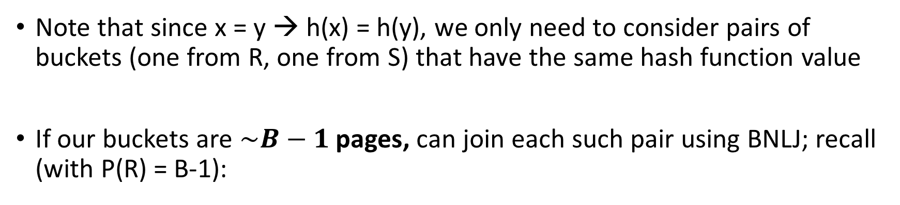

Hash Join Phase 2: Matching
Lecture 15 > Section 2 > HJ
Note that since x = y → h(x) = h(y), we only need to consider pairs of buckets (one from R, one from S) that have the same hash function value
If our buckets are $\sim B−1$ pages, can join each such pair using BNLJ; recall (with P(R) = B-1):
BNLJ Cost: $P\left(R\right)+ \frac{P\left(R\right)P(S)}{B−1}=P(R)+ \frac{(B−1)P(S)}{B−1}$ = P(R) + P(S)
Joining the pairs of buckets is linear!
(As long as smaller bucket <= B-1 pages)

Slide 114
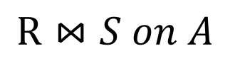
Hash Join Phase 2: Matching
Lecture 15 > Section 2 > HJ
h(1)=0
h(1)=0
h(2)=0
h(3)=1
h(3)=1
h(4)=1
h(5)=2
h(6)=2
h(6)=2
 | h(1) | h(1) | h(2) | h(2) | h(3) | h(4) | h(5) | h(6) | h(6)
$$R⋈S on A$$
R.A hashed values
S.A hashed values

Slide 115
Hash Join Phase 2: Matching
Lecture 15 > Section 2 > HJ
A=1
$$R⋈S on A$$
h(1)=0
h(1)=0
h(2)=0
h(3)=1
h(3)=1
h(4)=1
h(5)=2
h(6)=2
h(6)=2
 | h(1) | h(1) | h(2) | h(2) | h(3) | h(4) | h(5) | h(6) | h(6)
A=2
To perform the join, we ideally just need to explore the dark blue regions
= the tuples with same values of the join key A
A=3
R.A hashed values
A=4
A=5
A=6
S.A hashed values

Slide 116
Hash Join Phase 2: Matching
Lecture 15 > Section 2 > HJ
h(1)=0
h(1)=0
h(2)=0
h(3)=1
h(3)=1
h(4)=1
h(5)=2
h(6)=2
h(6)=2
 | h(1) | h(1) | h(2) | h(2) | h(3) | h(4) | h(5) | h(6) | h(6)
$$R⋈S on A$$
With a join algorithm like BNLJ that doesn’t take advantage of equijoin structure, we’d have to explore this whole grid!
R.A hashed values
S.A hashed values

Slide 117
Hash Join Phase 2: Matching
Lecture 15 > Section 2 > HJ
h(A)=0
$$R⋈S on A$$
h(1)=0
h(1)=0
h(2)=0
h(3)=1
h(3)=1
h(4)=1
h(5)=2
h(6)=2
h(6)=2
 | h(1) | h(1) | h(2) | h(2) | h(3) | h(4) | h(5) | h(6) | h(6)
With HJ, we only explore the blue regions
= the tuples with same values of h(A)!
h(A)=1
R.A hashed values
h(A)=2
S.A hashed values
We can apply BNLJ to each of these regions

Slide 118
Hash Join Phase 2: Matching
Lecture 15 > Section 2 > HJ
h'(A)=0
$$R⋈S on A$$
h'(A)=1
An alternative to applying BNLJ:
We could also hash again, and keep doing passes in memory to reduce further!
h'(A)=2
R.A hashed values
h'(A)=3
h'(A)=4
h'(A)=5
S.A hashed values

Slide 119
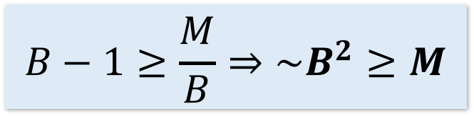
How much memory do we need for HJ?
Lecture 15 > Section 2 > Memory requirements
Given:
A fixed input size for R and S (M and N pages resp.)
B+1 buffer pages
Suppose (reasonably) that we can partition into B buckets in 2 passes:
For R, we get B buckets of size ~M/B
To join these buckets in linear time, we need these buckets to fit in B-1 pages, so we have:
WLOG: Assume M <= N
$$B−1≥\frac{M}{B}⇒\sim B^{2}≥M$$
Quadratic relationship between smaller relation’s size & memory!

Slide 120
Hash Join Summary
Lecture 15 > Section 2 > Memory requirements
Given enough memory (and letting R,S have size M,N resp.):
Partitioning requires reading + writing each page of R,S
→ 2(M+N) IOs
Matching (with BNLJ) requires reading each page of R,S
→ M+N Ios
Writing out results could be as bad as M*N… but probably closer to M+N
HJ takes ~3(M+N) + OUT IOs!

Slide 121
3. The Cage Match
Lecture 15 > Section 3 > The Cage Match

Slide 122
Sort-Merge v. Hash Join
Lecture 15 > Section 3 > The Cage Match
Given enough memory, both SMJ and HJ have performance:
“Enough” memory =
SMJ: B² > max{M,N}
HJ: B² > min{M,N}
~3(M+N) + OUT
Hash Join superior if relation sizes differ greatly. Why?
Notes:
16

Slide 123
Further Comparisons of Hash and Sort Joins
Lecture 15 > Section 3 > The Cage Match
Hash Joins are highly parallelizable.
Sort-Merge less sensitive to data skew and result is sorted

Slide 124
Summary
Lecture 15 > Section 3 > The Cage Match
Saw IO-aware join algorithms
Massive difference
Memory sizes key in hash versus sort join
Hash Join = Little dog (depends on smaller relation)
Skew is also a major factor

